Slide 1
REACT INTRO
By Volodymyr Karanevych

Slide 2
AGENDA
What is React?
Function component
Destructuring props

Slide 3
WHAT IS REACT?

Slide 4
INTRODUCTION
React is a declarative, efficient, and flexible JavaScript library for building user interfaces. It lets you compose complex UIs from small and isolated pieces of code called “components”.

Slide 5
HISTORY
React was created by Jordan Walke, a software engineer at Facebook. It was first deployed on Facebook's newsfeed in 2011 and later on Instagram in 2012.
It was open-sourced at JSConf US in May 2013.

Slide 6
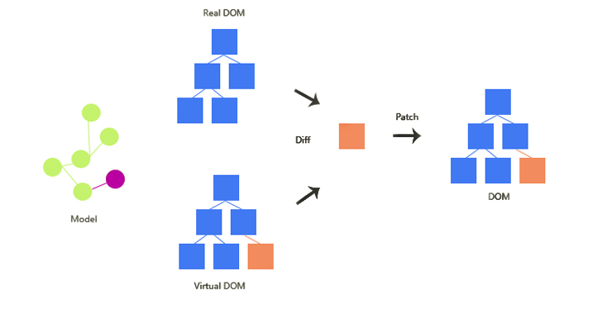
REACT PREFERENCES
Easy to read and
understand views
Concept of components is
the future of web
development
React is fast (because it
only manipulates the DOM)

Slide 7
HOW TO USE REACT?
Create React App is a comfortable environment for learning React, and is the best way to start building a new single-page application in React.
You’ll need to have Node >= 6 and npm >= 5.2 on your machine.
To create a project, run:
npx create-react-app app-name
cd app-name
npm start

Slide 8
JSX
JSX produces React “elements”.
Reactjs.org recommend using it with React to describe what the UI should look like. JSX may remind you of a template language, but it comes with the full power of JavaScript.

Slide 9

WHO USES REACT?

Slide 10
FUNCTION COMPONENTS

Slide 11
WHAT IS FUNCTION COMPONENTS?
Function components are the simplest way to declare reusable components.
They're just functions.
function Greeting() {
return <div>Hi there!</div>;
}
Elements can be represent as user-defined components:
<Greeting />;

Slide 12
PROPS
When React sees an element representing a user-defined component, it passes JSX attributes to this component as a single object. We call this object “props”.
For example, this code renders “Hello, Sara” on the page:
function Welcome(props) {
return <h1>Hello, {props.name}</h1>;
}
const element = <Welcome name="Sara" />;
ReactDOM.render( element, document.getElementById('root’) );
https://codepen.io/pen?editors=1010

Slide 13
PROPS ARE READ-ONLY!
Whether you declare a component as a function or a class, it must never modify its own props.
function sum(a, b) {
return a + b;
}
Such functions are called “pure” because they do not attempt to change their inputs, and always return the same result for the same inputs.
React is pretty flexible but it has a single strict rule:
All React components must act like pure functions with respect to their props.

Slide 14
COMPOSING COMPONENTS
Components can refer to other components in their output. This lets us use the same component abstraction for any level of detail. A button, a form, a dialog, a screen: in React apps, all those are commonly expressed as components.
For example, we can create an App component that renders Welcome many times:

Slide 15
function Welcome(props) { return <h1>Hello, {props.name}</h1>; }
function App() {
return (
<div>
<Welcome name="Sara" />
<Welcome name="Cahal" />
<Welcome name="Edite" />
</div>
);
}
ReactDOM.render( <App />, document.getElementById('root') );
https://codepen.io/pen?&editable=true&editors=0010

Slide 16
EXTRACTING COMPONENTS
Don’t be afraid to split components into smaller components.
Extracting components might seem like grunt work at first, but having a palette of reusable components pays off in larger apps.
A good rule of thumb is that if a part of your UI is used several times or is complex enough on its own, it is a good candidate to be a reusable component.

Slide 17
DESTRUCTURING PROPS

Slide 18
WHAT IS DESTRUCTURING?
Destructuring was introduced in ES6. It’s a JavaScript feature that allows us to extract multiple pieces of data from an array or object and assign them to their own variables.
Imagine you have a person object with the following properties:
const person = {
firstName: "Lindsay",
lastName: "Criswell",
city: "NYC"
}

Slide 19
Before ES6, you had to access each property individually:
console.log(person.firstName) // Lindsay
console.log(person.lastName) // Criswell
console.log(person.city) // NYC
Destructuring lets us streamline this code:
const { firstName, lastName, city } = person; is equivalent to:
const firstName = person.firstName
const lastName = person.lastName
const city = person.city

Slide 20
So now we can access these properties without the person. prefix:
console.log(firstName) // Lindsay
console.log(lastName) // Criswell
console.log(city) // NYC

Slide 21
DESTRUCTURING PROPS
Destructuring really shines in React apps, where it can greatly simplify how you write props.
Take for example an <Attraction /> component from a travel app. I wanted to pass it attraction props that look like this:

Slide 22
props = {
attraction: {
name: “Statue of Liberty ",
address: "US New York, 350 5th Ave",
average_rating: 4,
id: 9,
}
}

Slide 23
Not only is this way more information than we need in <Attraction /> component, it makes for some pretty ugly JSX when we needed to pass down different pieces of props to children components.
const Attraction = props => {
return (
<div key={props.attraction.id}>
<h1>{props.attraction.name}</h1>
<p>{props.attraction.adress}</p>
<StarRatings rating={props.attraction.average_rating} />
</div>
);
};

Slide 24
Destructuring our props lets us drop all of the props.
const Attraction = ({ attraction }) => {
return (
<div key={attraction.id}>
<h1>{attraction.name}</h1>
<p>{attraction.adress}</p>
<StarRatings rating={attraction.average_rating} />
</div>
);
};

Slide 25
We can make this code even simpler by destructuring the auth and attractions props like so:
const Attraction = ({attraction: { name, adress, average_rating, id }}) => {
return (
<div key={id}>
<h1>{name}</h1>
<p>{adress}</p>
<StarRatings rating={average_rating} />
</div>
);
};

Slide 26
DESTRUCTURING IN CLASS COMPONENTS
Destructuring works similarly in class components, with slightly different syntax.
Here you destructure props in the render() function.

Slide 27
class Attraction extends React.Component {
render() {
const { attraction: { name, adress, average_rating, id} } = this.props;
return (
<div key={id}>
<h1>{name}</h1>
<p>{adress}</p>
<StarRatings rating={average_rating} />
</div> );
}
}

Slide 28
Destructuring props made this code much easier to read.
It has the added benefit of giving us access only to the props we need, and letting us view them on the file where we use them.

Slide 29
USED MATERIALS
https://reactjs.org/docs/components-and-props.html#function-and-class-components
https://en.wikipedia.org/wiki/Pure_function
https://reactjs.org/docs/components-and-props.html
https://medium.com/tag/react
https://reactpatterns.com

Slide 30
THANK YOU

